Slide 1
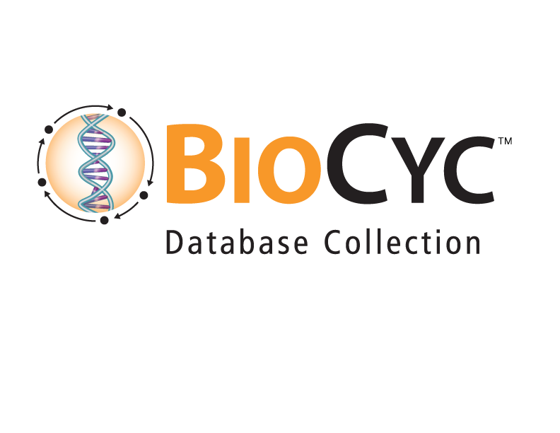
BioCyc Omics Analysis Tools
Suzanne Paley, SRI International

Slide 2
Transcriptomics / Metabolomics Data Analysis
Pathway visualization of gene expression and metabolomics data
Zoomable metabolic map
Individual pathways
Groups of pathways: pathway collages, tables of perturbed pathways
Omics Dashboard
Graph-based visualization using hierarchical systems of cellular function
Enrichment analysis
Pathways, GO terms, Regulators over-represented in gene sets
Pathways over-represented in metabolite sets
Monoisotopic mass search, metabolite translation service
Genome Browser tracks, e.g. for ChIP-Chip data

Slide 3
Input Data File Format
Tab-delimited text file
1st column contains gene/metabolite identifiers
Gene accession
Common name, synonym
Links to other DBs, prefixed by DB id, e.g. KEGG:C00078, UniProt:P80041
Internal BioCyc identifier
Metabolite InChi, chemical formula, monoisotopic molecular weight
Combination of above, separated by $, e.g. spermidine$KEGG:C00315$PubChem:6992097
One or more numeric data columns
“Absolute” values, e.g. counts, intensities
“Relative” values, e.g. ratios, log ratios

Slide 4
The Omics Dashboard

Slide 5
Omics Dashboard
Interactive tool for analysis of omics data
Gene expression
Proteomics
Metabolomics
Reaction fluxes
Use cases:
Understand an omics dataset at multiple levels
High-level survey of responses of many cellular systems
Examine specific pathways, subsystems of interest in detail
Functional filtering of an omics dataset
Visualization provides quick understanding of quantitative behavior
Visually detect patterns missed by simple statistical filtering

Slide 6
Dashboard Systems and Subsystems
Derived from
MetaCyc Pathway Ontology (355 classes, many individual pathways)
E.g. Biosynthesis, Energy Metabolism, Cofactor Biosynthesis, TCA Cycle
Gene Ontology terms (80 terms)
Hand-curated subset, mostly Biological Process, some Cellular Component
E.g. Response to Stimulus, Biofilm, Protein Folding, Outer Membrane Proteins
Other
Transporters, Regulons, Sigma Factors
Organism-specific
Dataset-specific
Users can add or remove plots from any panel
Users can create new subsystems from gene set, pathway set, GO term

Slide 7
Accessing the Omics Dashboard

Slide 8
Sample Dataset
Escherichia coli transcriptomics data
Von Wulffen et al Genes 8(3) 2017
10 minute time course following shift from anaerobic to aerobic growth
Normalized average RNA-seq read counts on Y-axis

Slide 9
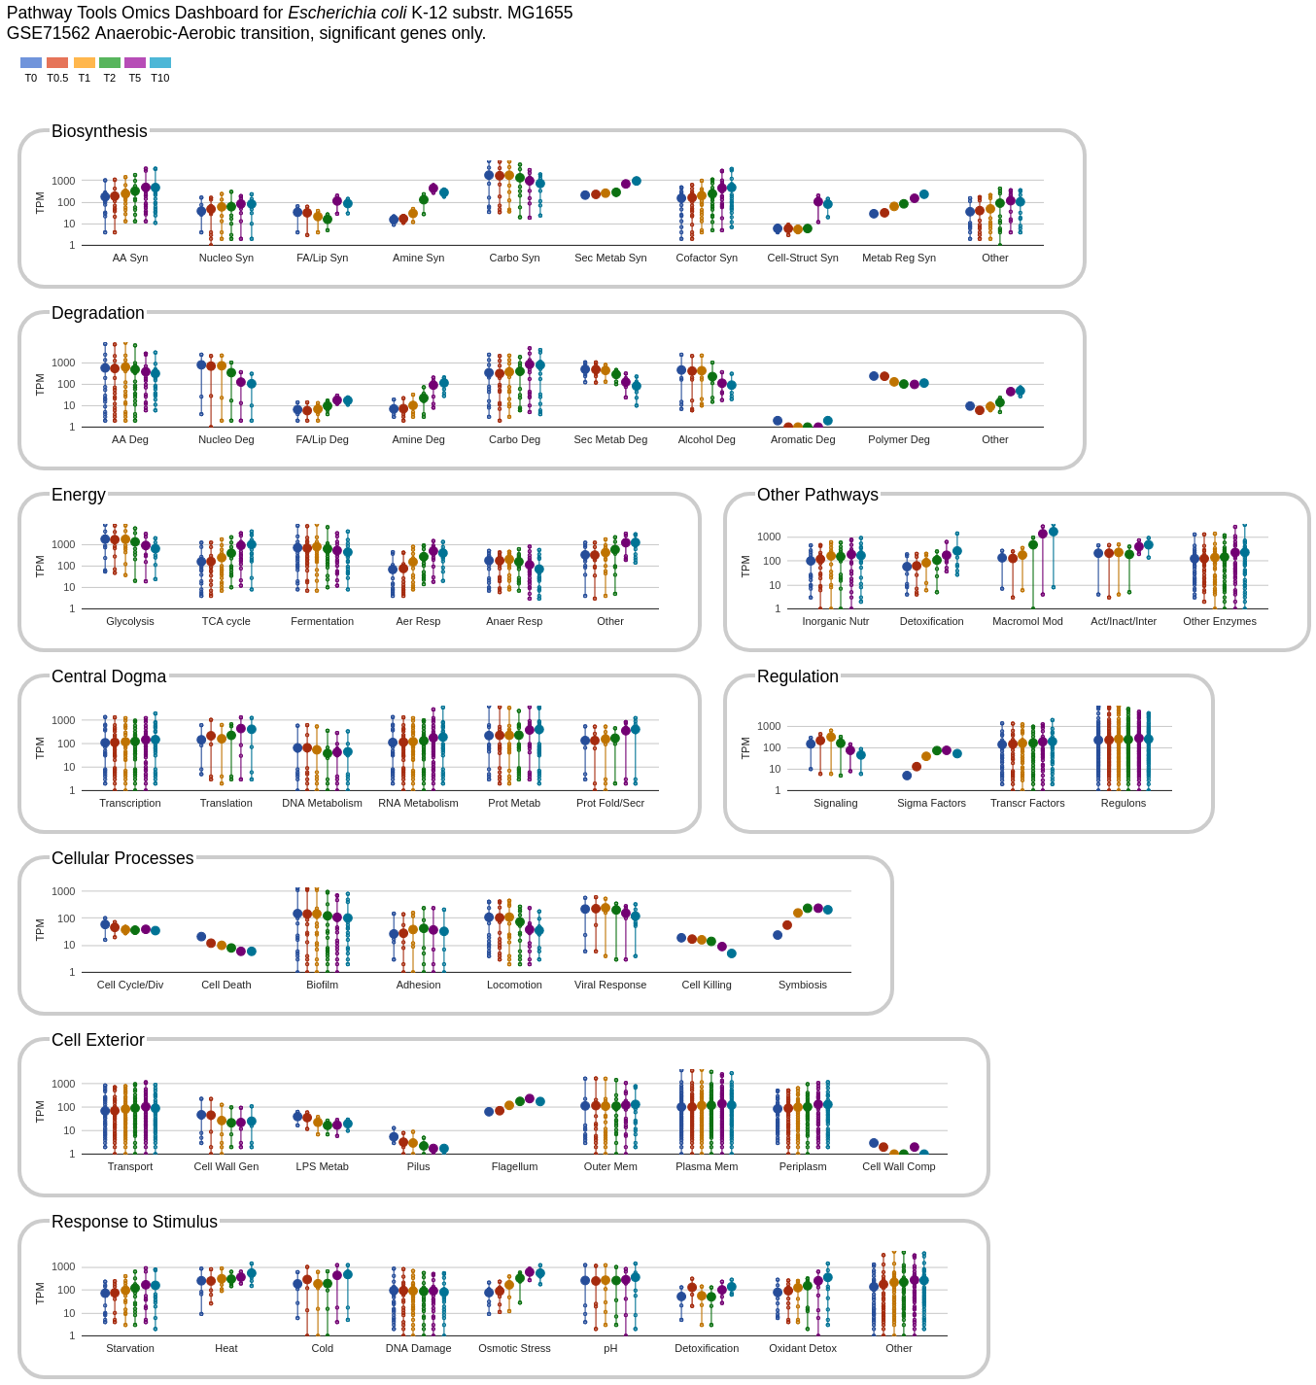
Organization of Omics Dashboard
A series of panels summarize omics data for different cellular systems
Each panel contains a set of plots (subsystems)
Implemented in JavaScript, using Google Charts
Notes:
Each point on a vertical line is a reading for one gene.
Set of metabolites on one vertical line are all genes in that subsystem for which data is available.
Large point is the average.

Slide 10
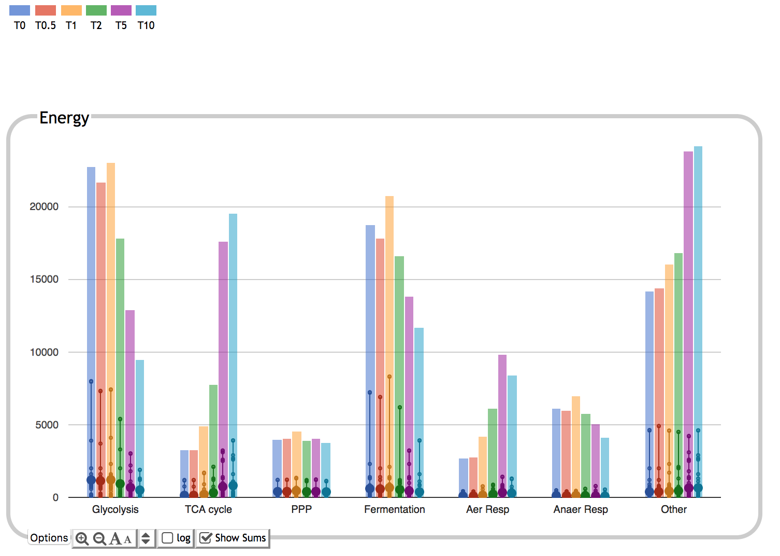
Colors correspond to timepoints
Bar height corresponds to sum of expression values for all genes in subsystem
Large dots show average over all genes in subsystem
Small dots correspond to individual gene expression values

Slide 11
Notes:
Four panels are metabolic, five panels are non-metabolic.

Slide 12
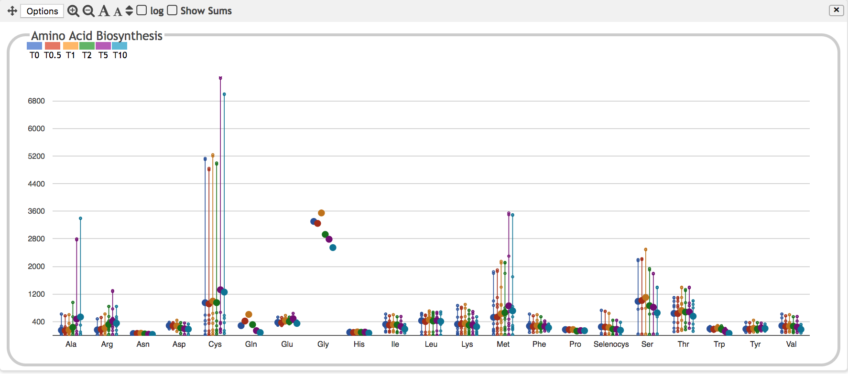
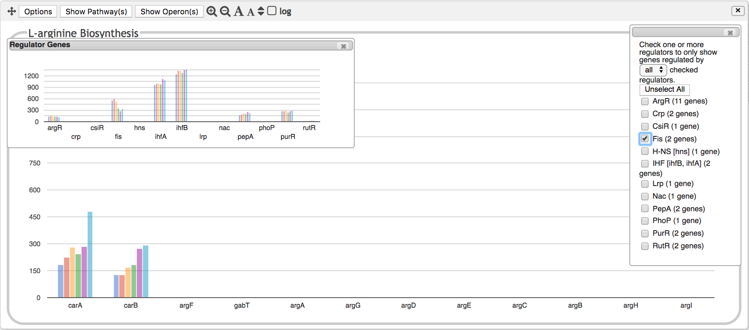
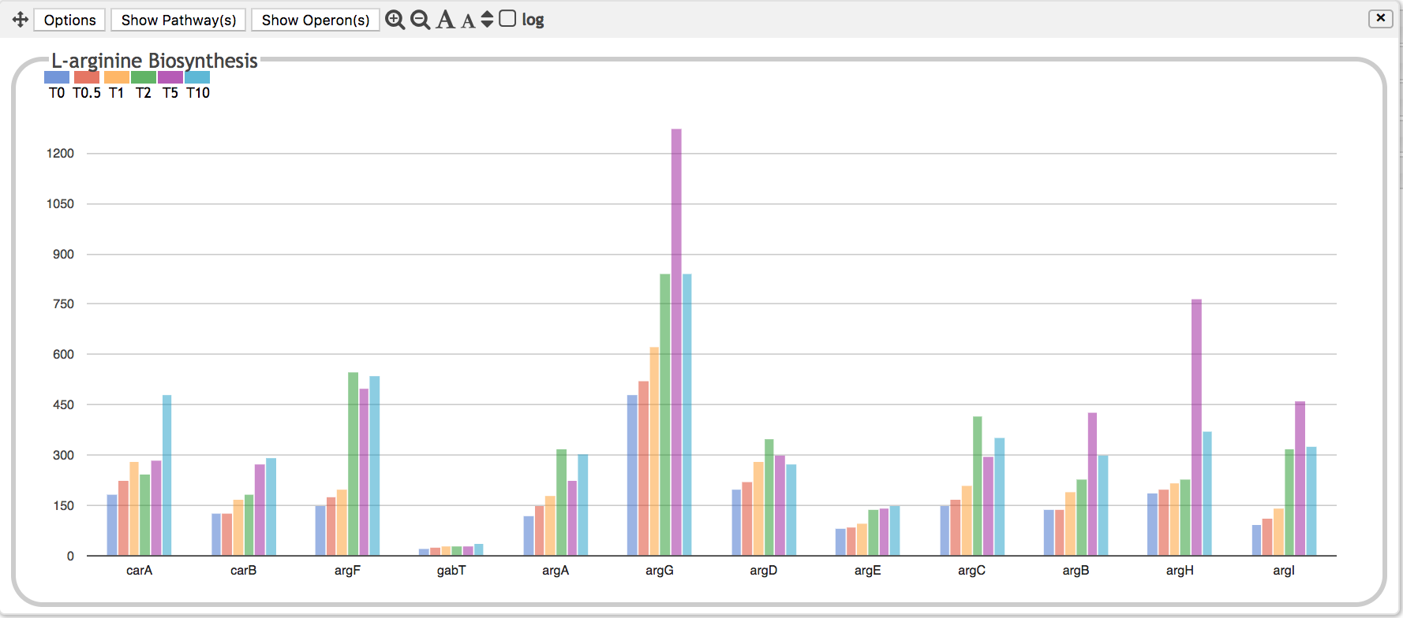
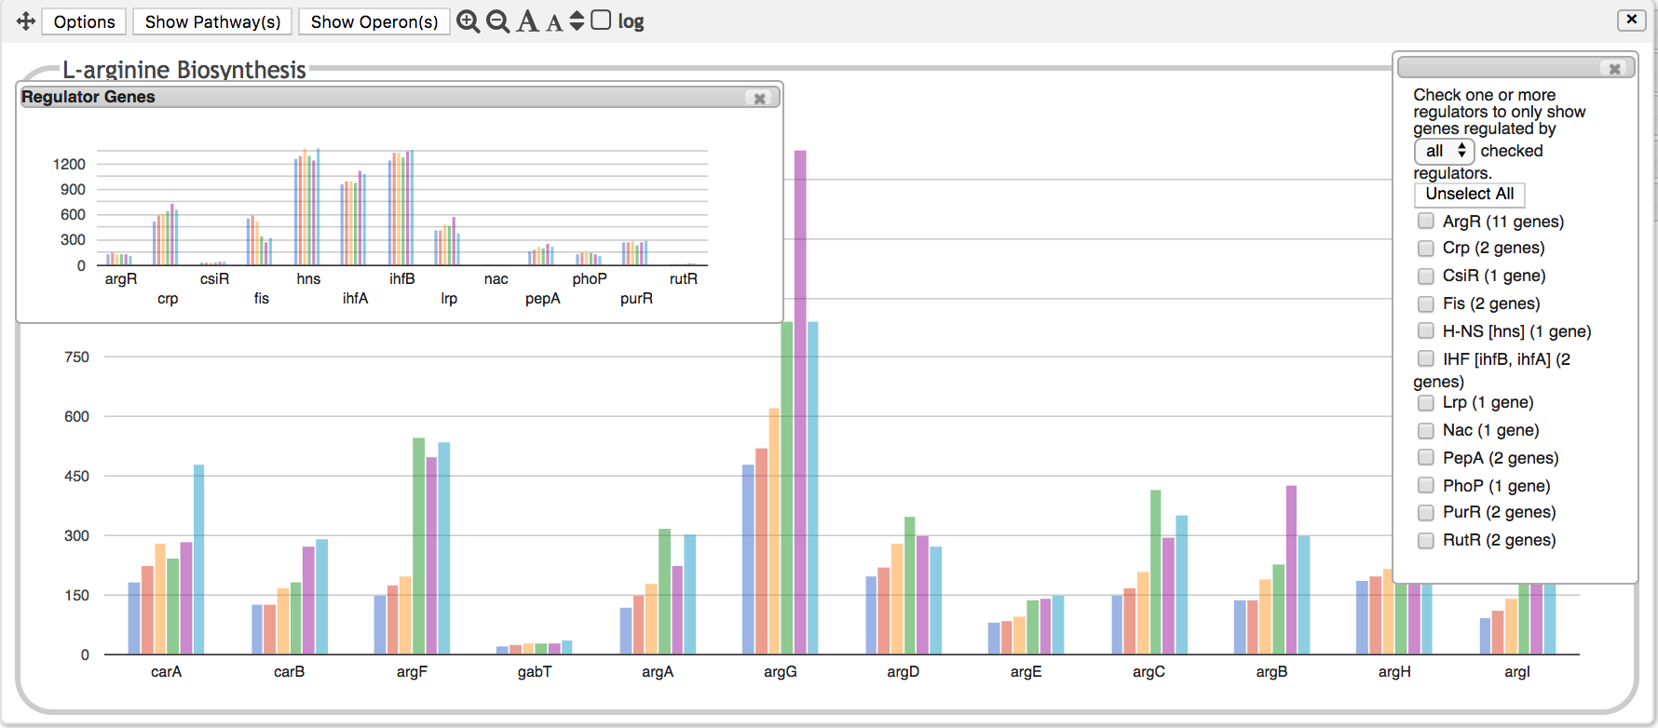
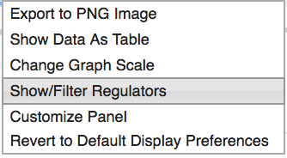
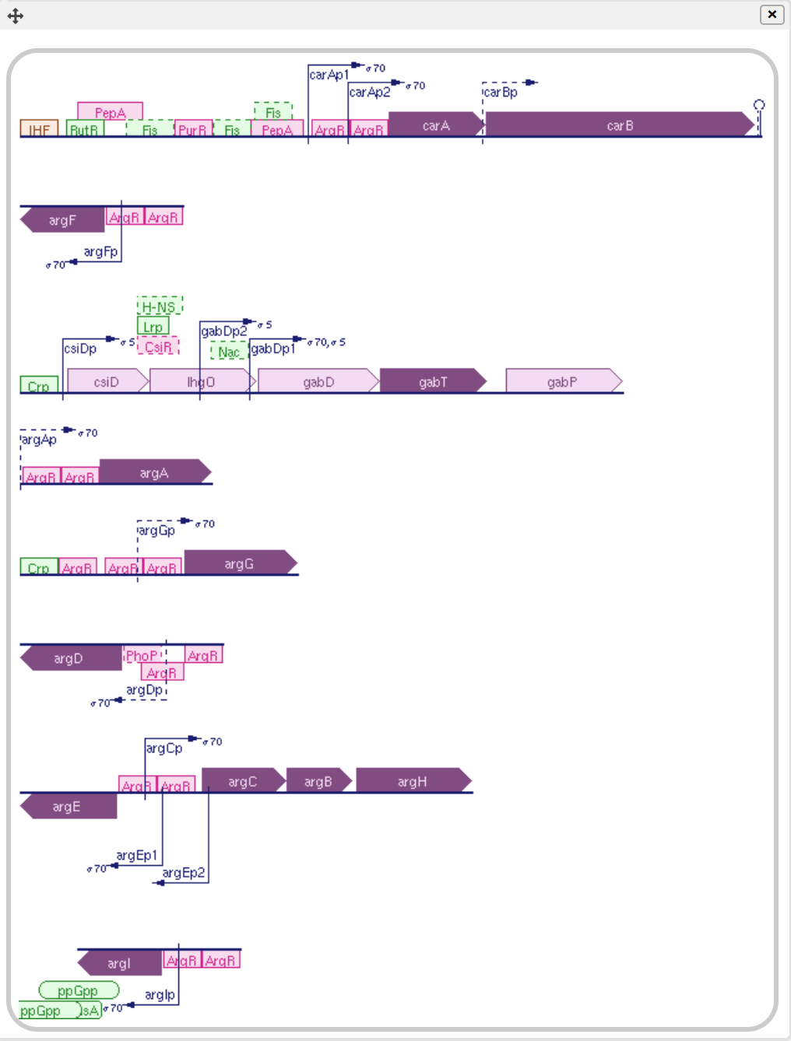
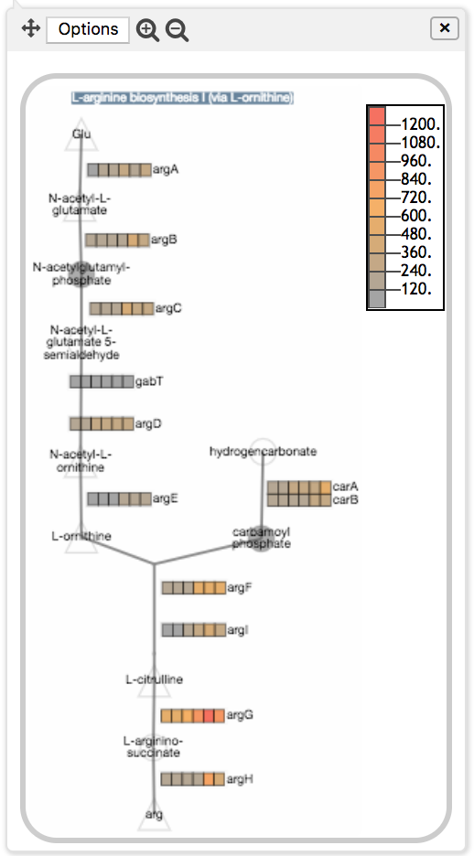

Slide 13
Other Capabilities
Choose log or linear scale
Customize panel size, vertical scale
Sort by gene position, alphabetical, data value
Select which data series to show/hide
Average data for multiple replicates
Perform enrichment analysis
Generate table of data for selected panel
Export to SmartTable

Slide 14
Using the Dashboard
Apply normalization and significance calculations before uploading data, if applicable.
Decide whether to average replicates before upload, or have dashboard do it for you (performance implications)
Import data as a column-delimited file
Gene names/metabolite names/IDs in first column
Specify which other columns contain data of interest
Types of data values
Fold change values
Absolute quantities (counts, areas, intensities)
P-values from replicate analysis (used for enrichment analysis)
Modify diagram scale as needed, choose log vs linear

Slide 15
Enrichment Analysis
Which systems have more perturbed genes than expected by chance?
User specifies
A p-value column associated with each timepoint
Threshold (0.05 in this example)
Multiple hypothesis correction function
Compute enrichment score for every system, subsystem
Fisher-exact hypergeometric test
Enrichment score for a system = -log₁₀(p-value)
Panels show
Enrichment scores for each system
Highest component subsystem score

Slide 16
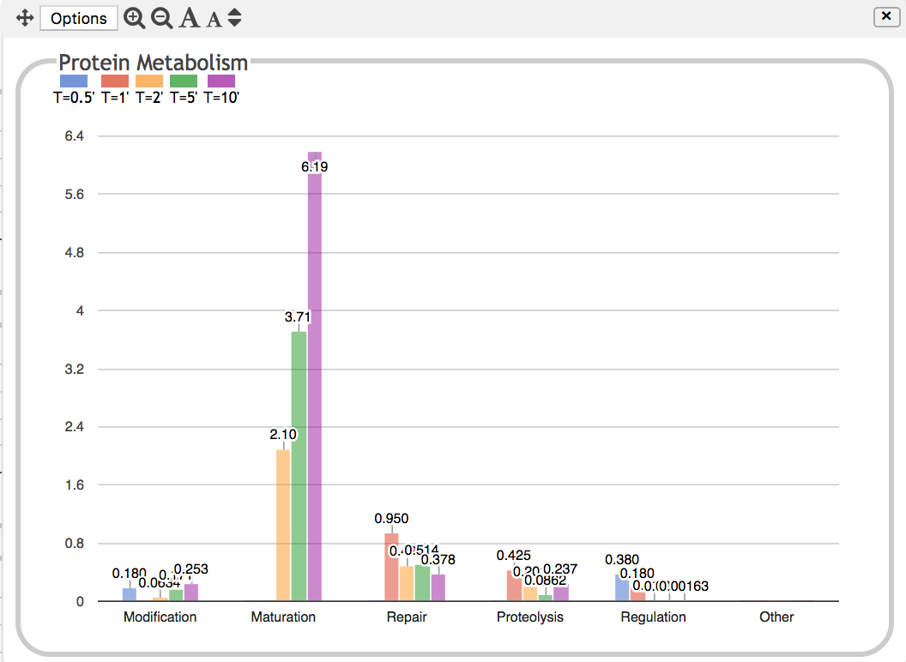

Slide 17
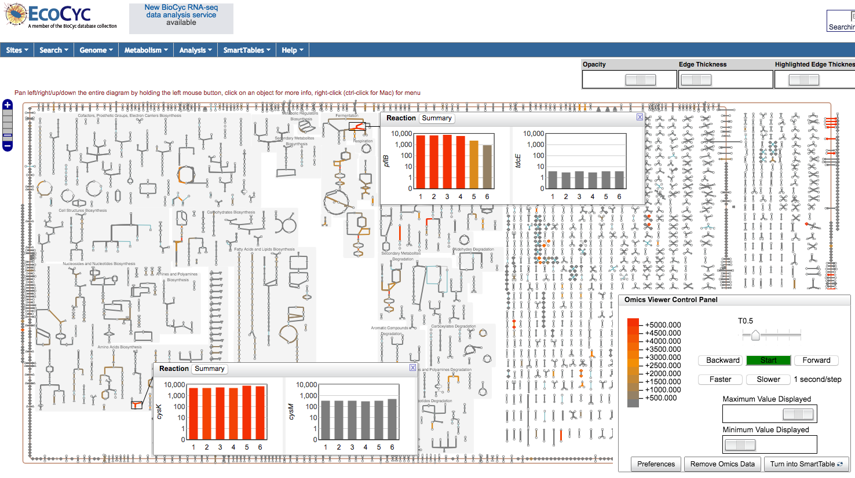
Transcriptomics Data on Cellular Overview

Slide 18
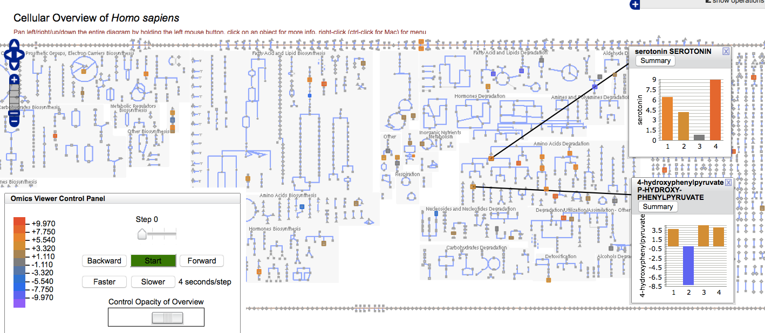
Paint Metabolomics Data onto Cellular Overview

Slide 19
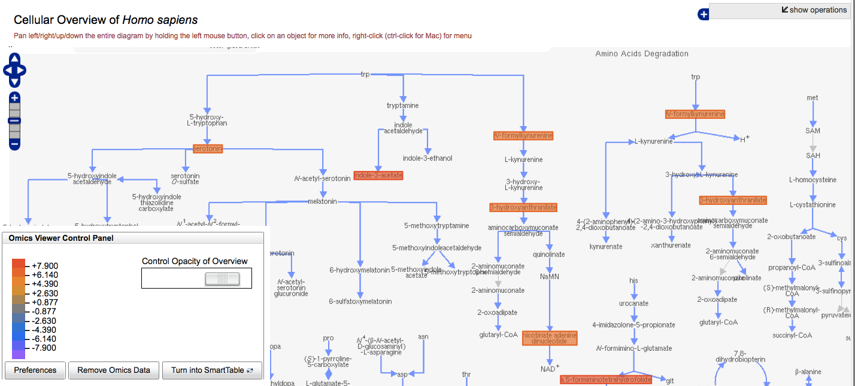
Paint Metabolomics Data onto Cellular Overview

Slide 20
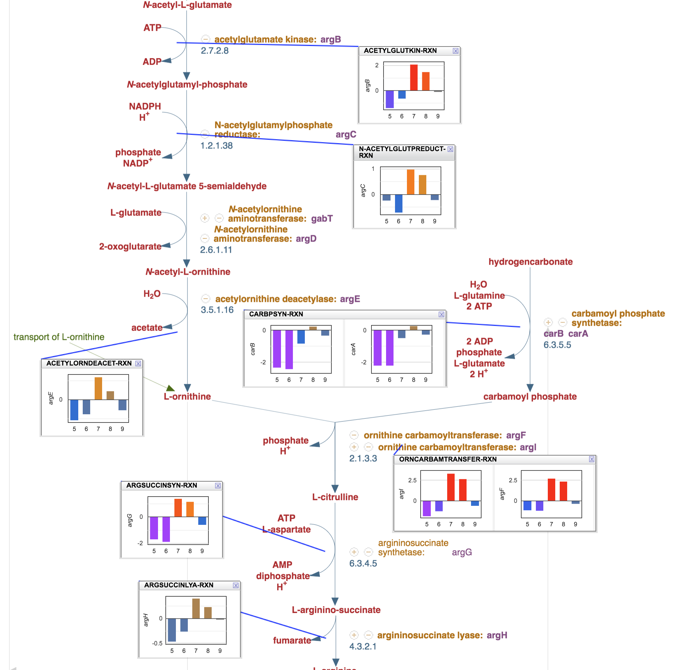
Gene Expression Data on Single Pathway

Slide 21
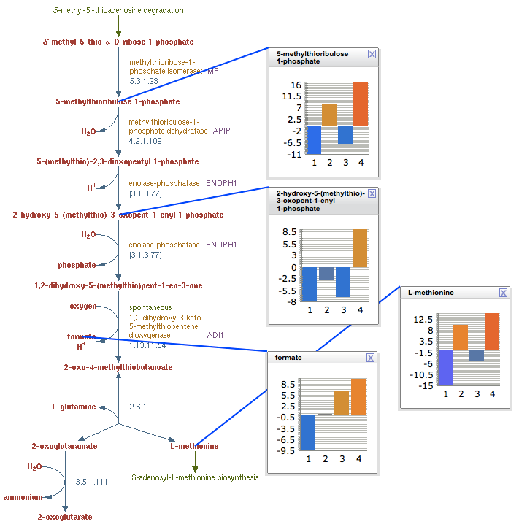
Metabolomics Data Painted onto Individual Pathway

Slide 22
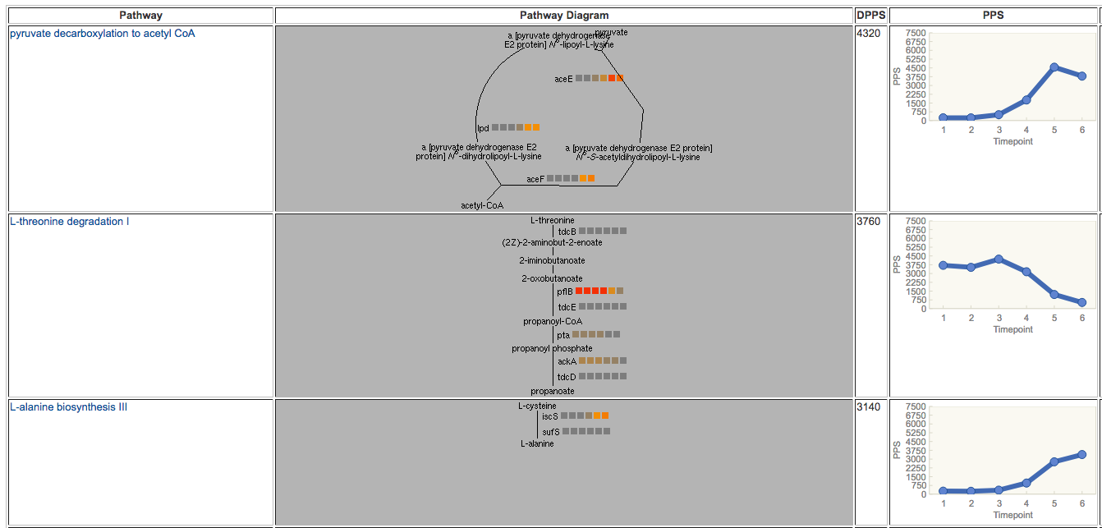
Table of Perturbed Pathways

Slide 23
Pathway Perturbation Score
Extent to which a pathway is up/down-regulated
Based on reaction perturbation scores RPS or DRPS
Single time point: RPS based on fold change (FC) over all metabolites or genes of reaction
RPS(R) = max(|FC(R)|) over all metabolites or genes associated with R
PPS for pathway P computed from reactions R_{i} of P:
PPS(P) = √sum(RPS(R_{i})²)
Multiple time points: DRPS based on maximum difference over all timepoints, over all metabolites or genes of reaction:
DRPS(R) = max (|(max(FC(R)_{t1-N}) – min (FC(R)_{t1-N})|)
DPPS(P) = √sum(DRPS(R_{i})²)

Slide 24
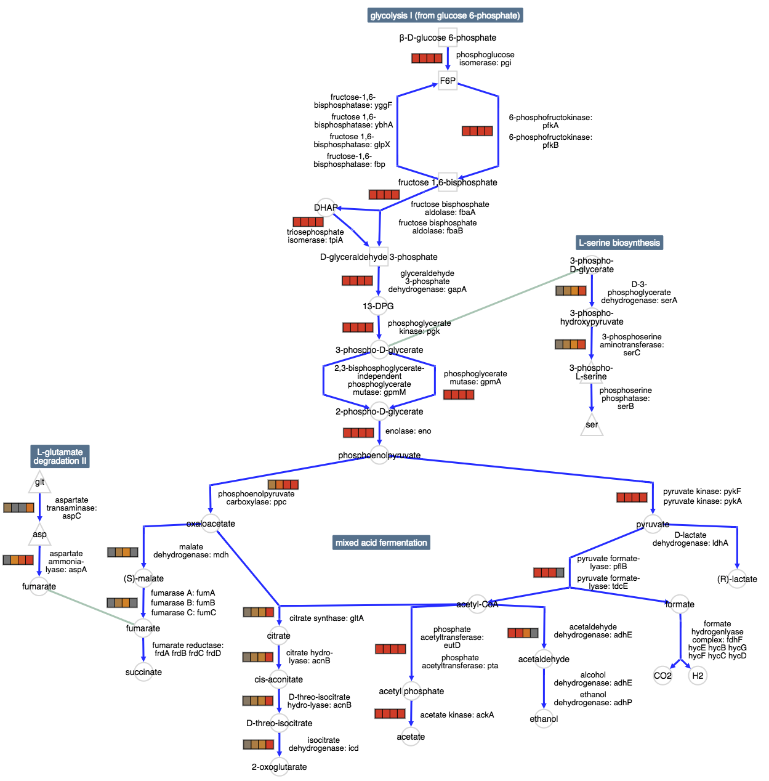
Pathway Collage with Reaction Flux Data

Slide 25
SmartTables: Enrichment Analysis
“My experiments yielded a set of genes/metabolites. What do they have in common?”
Given a group of genes:
What GO terms are statistically over-represented in that set?
What metabolic pathways are over-represented?
What transcriptional regulators are over-represented?
Given a set of metabolites:
What metabolic pathways are statistically over-represented in that set?

Slide 26
Enrichment Analysis

Slide 27
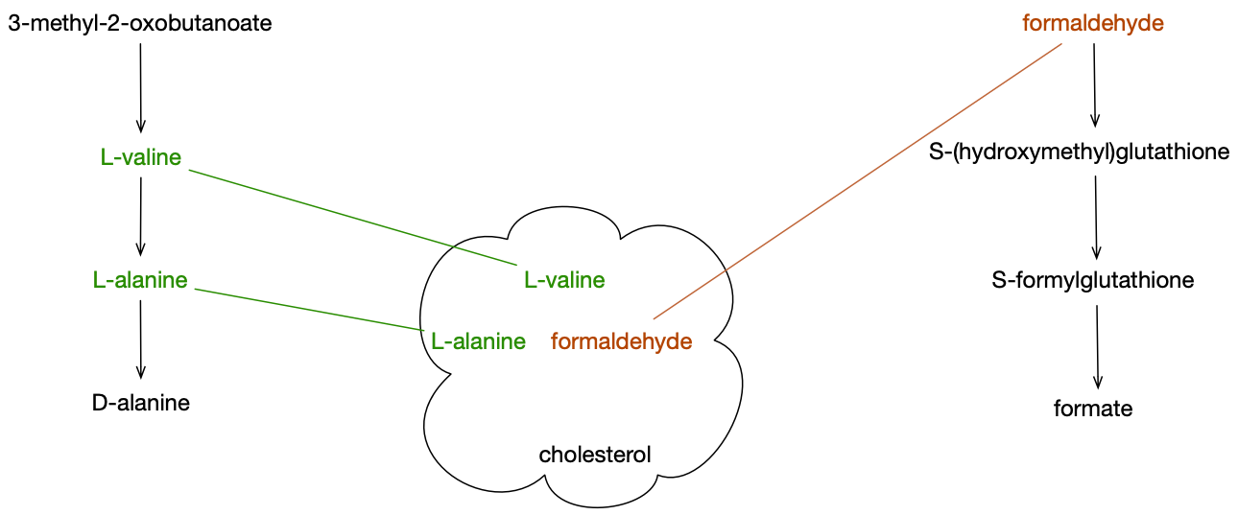
Pathway Covering of Input Metabolite Set
Pathway 1
Pathway 2
Input Covering Set
Notes:
Cholesterol is not covered because there are no pathways in E. coli for this compound

Slide 28
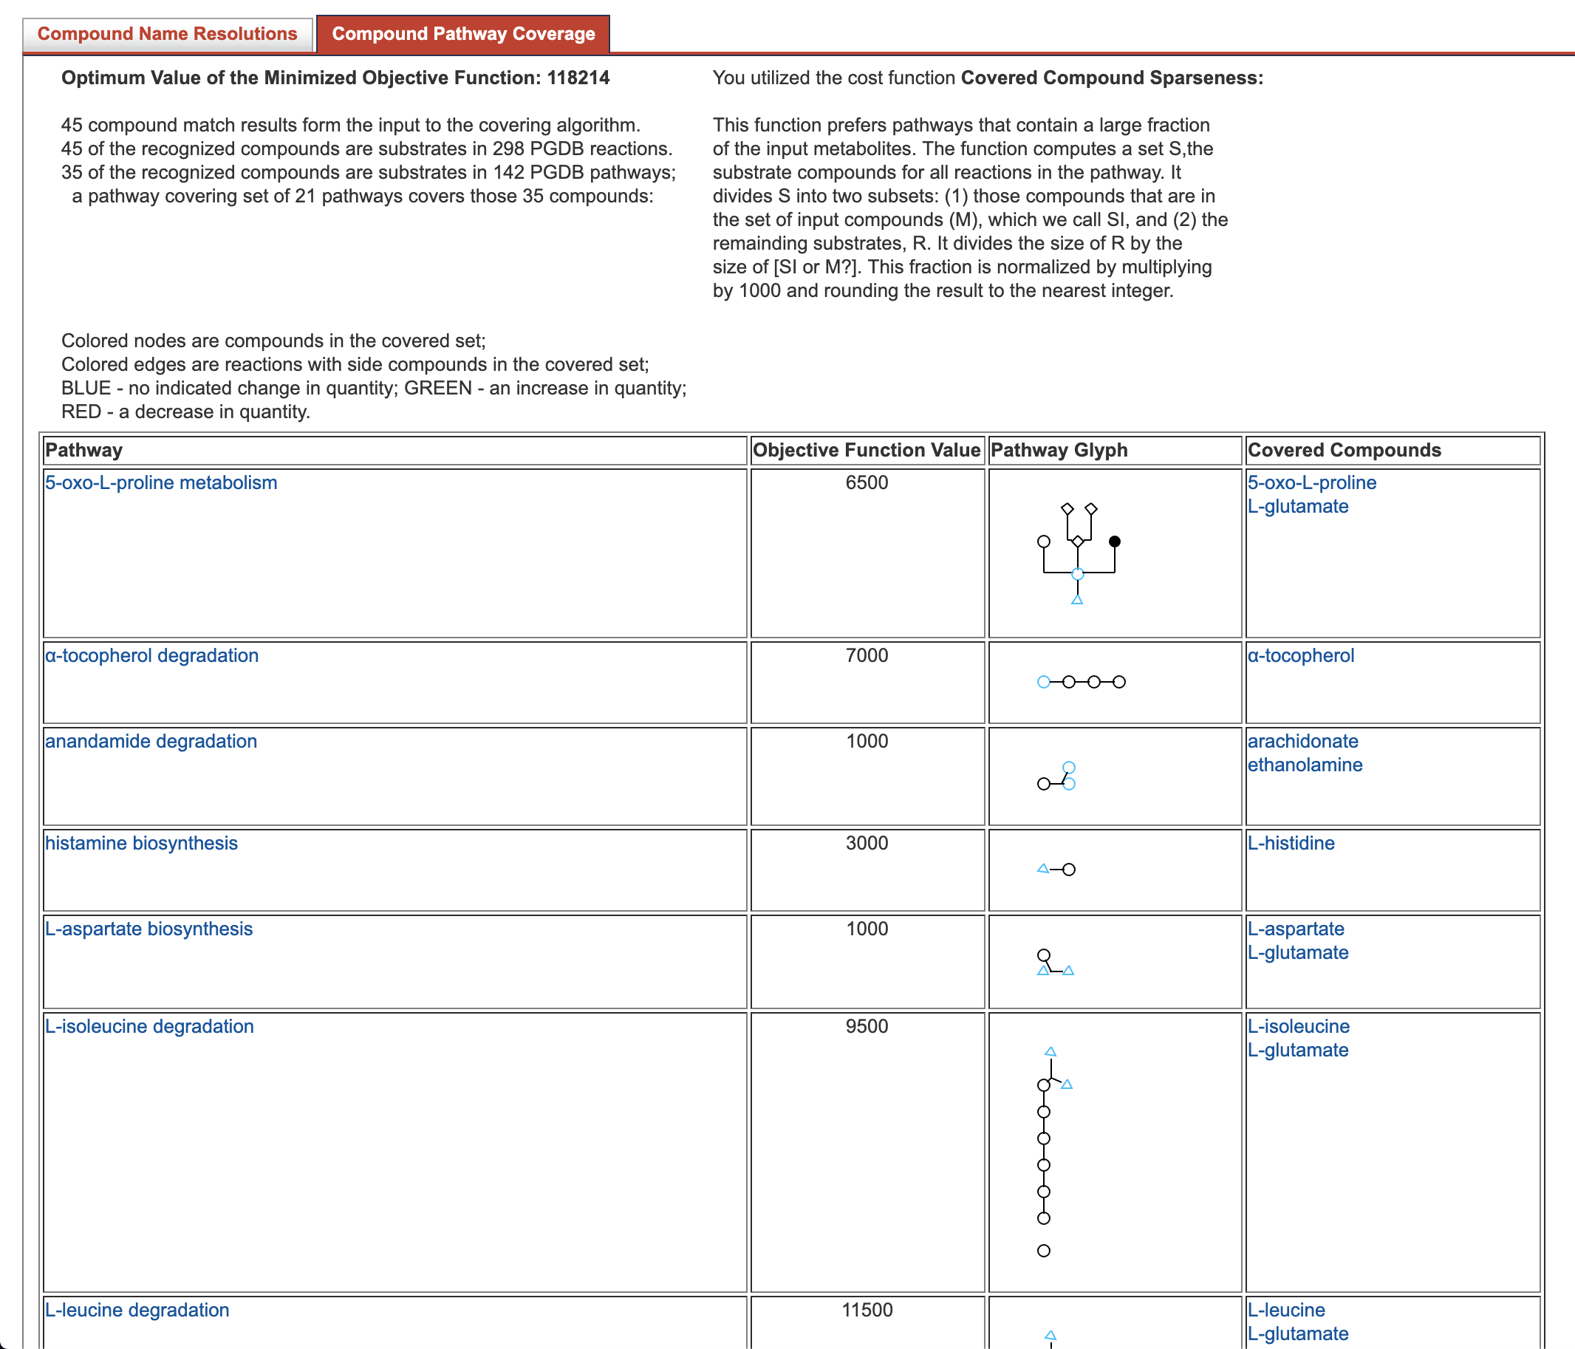
Notes:
Portion of pathway covering output. Input compounds from a Metabolomics Workbench study (ST000741) using pathways from HumanCyc 23.0.

Slide 29
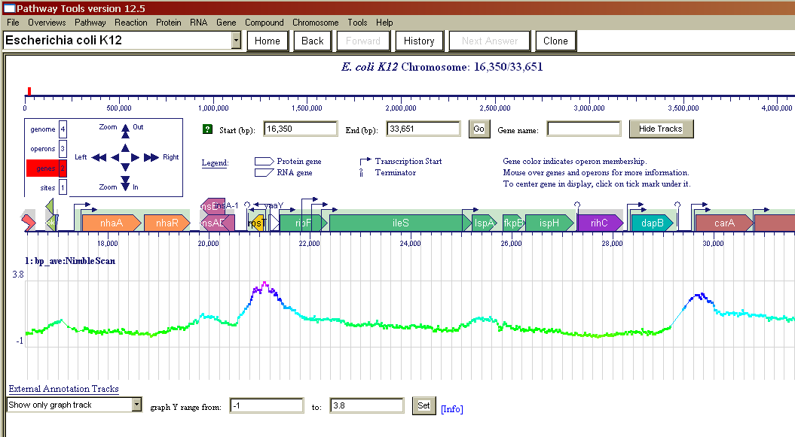
Genome Browser ChIP-Chip Data Shown in Graph Track

Slide 30
Pathway Collages

Slide 31
What is a Pathway Collage?
Web Application (but accessible from both web and desktop PTools)
User-specified set of Pathway Diagrams
Zoomable, Editable, Customizable
Generate High-Quality Images for Publications and Presentations
Overlay Omics Data
Implemented in JavaScript using Cytoscape.js

Slide 33
Operations
Adjust position of pathways, metabolites, etc.
Edit labels
Customize appearance of nodes, edges
Show connections between pathways
Merge duplicate metabolites, delete entities
Add pathways involving metabolite
Highlight metabolites, reactions, enzymes of interest
Show/Hide Omics Data
Tooltips provide links to BioCyc/PTools pages
Save/Reload/Export to PNG

Slide 34
Accessing Pathway Collage App

Slide 35
Pathway Collage from a SmartTable

