Slide 1
Pathway/Genome Navigator
Peter D. Karp ecocyc.org
SRI International biocyc.org
metacyc.org

Slide 2
The following takes about 1 hr:
Tutorial on desktop Nav using slides 1-36
Following script in file Navigator tutorial script – Desktop.docx

Slide 3
Introduction
Navigator runs via desktop mode and web mode
The two versions are similar, but each has unique features
Navigator functions:
Search
Genome browser
SmartTables
Omics data analysis
Metabolic route search
Browse metabolic network
Browse regulatory network

Slide 4
Navigator Desktop Mode

Slide 5
Desktop Layout
One large window
Several panes:
Display pane
Current organism
Quick Search
Listener pane
Command menu

Slide 6
Desktop Menus
Main command menu
Single-choice menu
Multiple-choice menu (e.g. after a search)
Aborting out of menus
Click Cancel or No Select
Click outside the menu
Type ^Z

Slide 7
The Mouse
Left mouse button: to invoke specific commands and for hypertext navigation
Right mouse button: to bring up menus of additional operations (for example, when editing)
Tooltips (show information on what you’re over)

Slide 8
Organism Pages
All Organisms Page
Single organism page
Notion of current organism or current organism set
Command mode queries

Slide 9
Exercise
Select one or more different organisms

Slide 10
Searches
Search by type (for example, search for proteins)
Searches common to all types
By name/frame ID – must be exact (though there are synonyms)
By substring – if you don’t know an exact name
Particular searches by type
Will be handled as we cover each type
Quick Search

Slide 11
Queries with multiple answers
Results in form of a menu to:
select one
some
all
Answer List
Next Answer

Slide 12
History List
Backward history
Forward history
Select from history

Slide 13
Writing Complex Queries
Web Search → Advanced
Write queries in LISP
Must understand features of schema
class names
slot names
Pathway tools site has example searches
Definitely learnable
Can place results on the answer list

Slide 14
The Principal BioCyc Page Types
Organism
Gene
Metabolite (Compound)
Reaction
Pathway
Transcription Unit

Slide 15
What’s in a Gene/Protein Page?
Sample frame (ArgD)
Synonyms, general features, comments
Unification links, gene-reaction schematic
GO terms
Enzymatic reaction frames – how this protein carries out that reaction (bridging the two)
Evidence codes

Slide 16
Desktop Lab Exercises
Find the pykA gene in E. coli K-12
Find the E. coli K-12 gene whose locus id is b2222
Find E. coli protein pyruvate kinase
Find all kinases in E. coli
Find all E. coli proteins whose molecular weight is less than 5 Kdaltons

Slide 17
Desktop Lab Exercises
Find the pykA gene in E. coli K-12
Gene -> Search by name or Frame ID: “pykA”
Find the E. coli K-12 gene whose locus id is b2222
Gene -> Search by name or Frame ID: “b222”
Find E. coli protein pyruvate kinase
Protein -> Search by name or Frame ID: “pyruvate kinase”
Find all kinases in E. coli
Protein -> Search by substring -> “kinase”
Find all E. coli proteins whose molecular weight is less than 5 Kdaltons
Protein -> Search by Weight, PI

Slide 18
Gene-Reaction Schematic
Drawn in reaction, protein, and gene windows
Representations (ArgB)
Genes are boxes on the right
Proteins are circles in the middle – numbers show complexes
Reactions in box on left, with E.C. number if available
Allows navigation between genes, proteins, rxns
Links proteins with shared reactions
ArgD
Links members of protein complexes
Pol III – extreme example

Slide 19
Citations and Summaries
Citations in mnemonic form
Click on citation – go to citations at bottom of page
Click there, go to PubMed ref, if available

Slide 20
Database Links
Unification links (info about the gene/protein/RNA elsewhere)
PIR
RefSeq
UniProt
Gene page: E.g. for E. coli, we added links to E. coli-specific sites
Relationship links:
PDB

Slide 21
Class Hierarchies
Pathways
Reactions
Enzyme-nomenclature system (full EC system in MetaCyc only)
Proteins
Gene Ontology terms are assigned to proteins
Can also assign MultiFun terms
Compounds

Slide 22
What’s in a TU Page?
Sample frame (argCBH)
Genes in context, with TFs
Promoter with transcription start site and citations
TF binding sites, with citations
Regulatory interactions (ilvL attenuator in TU524)

Slide 23
Pathway Menu Commands
Search by pathway name
Search by substring
Search by class
Search by substrates (can pick role in pathway)

Slide 24
What’s in a Pathway Page?
Go to arginine biosynthesis I (from ArgD)
Intermediates and reactions
Can toggle level of detail
Feedback regulation can be shown
Locations of mapped genes
Genetic regulation schematic
Note presence of summaries, citations, class hierarchy

Slide 25
Reaction Menu Commands
Search by reaction name
Search by E.C. #
Search by class (another E.C. interface)
Search by pathway
Search by substrates

Slide 26
What’s in a Reaction Page?
Search by EC for 2.6.1.11 (pick one)
Picture of reaction with clickable compounds
Pathways the reaction is involved in
Place in class hierarchy
Enzymes carrying out reaction (note schematic)

Slide 27
Desktop Lab Exercises
Find the glutamine biosynthesis pathway by issuing each of the three types of queries in Pathway mode.
Find all cofactor biosynthesis pathways
Find the reaction whose EC number is 2.7.1.40
Find all reactions that convert glutamate to glutamine

Slide 28
Compound Menu Commands
Search compound by name
Search compound by substring
Search by SMILES (structure)
Search by class
Advanced search

Slide 29
The SMILES Language
Simplified Molecular Input Line Entry System
Formal language for describing chemical structures
Used within the Pathway Tools in a substructure search
Case is significant (lowercase for aromatic rings)
Examples:
formate C(=O)O
malate OC(=O)CC(O)C(O)=O
For more information, see the Help facility

Slide 30
What’s in a Metabolite Page?
Sample (N-acetylglutamyl-phosphate)
Synonyms, empirical formula, MW, links
Structure (you can add these in editors)
SMILES code
Pathways and reactions involving this compound

Slide 31
Miscellaneous Commands
History commands
Answer-List commands
Clone window command
Fix window and unfix window commands
Other commands:
Print to file (makes a postscript file)
Help
Preferences
Exit

Slide 32
User Preferences
Color
Layout
Compound window
Reaction window
Pathway window
History/Answer list
Reverting and saving user preferences

Slide 33
Desktop Exercises
Find the page for pyruvate
What proteins transport pyruvate into the cell, using what transport reactions?
Retrieve compounds containing a formate group
Retrieve all reactions involved in proline biosynthesis

Slide 34
Desktop Exercises
Find the page for pyruvate
Compound -> Search by name or Frame ID: “pyruvate”
What proteins transport pyruvate into the cell, using what transport reactions?
Look for transport section in page for pyruvate; click to reaction page to find the genes
Retrieve compounds containing a formate group
Compound -> Search by SMILES substructure: “C(O)=O”
Retrieve all reactions involved in proline biosynthesis
Reaction -> Search by Pathway: Navigate to L-proline biosynthesis I via menu hierarchy via Biosynthesis, Amino Acid Biosynthesis, etc

Slide 35
Lab Exercises
Set up personal preferences for:
Color
Layout (set number of windows to 2)
Save new preferences
Play with settings for Compound, Reaction, Pathway, and Overview windows.
Choose settings for History/Answer List preferences

Slide 36
Desktop Lab Exercises
Clone a window
Navigate in the cloned window
Set preferences so Navigator displays 2 windows
Navigate by clicking on live objects
Fix Window
Navigate in unfixed window
Fix second window and then click on live object

Slide 37
Pathway Tools Web Mode [This portion is way out of date]

Slide 38
Multiple Web Entry Points
BioCyc.org
EcoCyc.org
BsubCyc.org
Pseudomonas.biocyc.org
Mycobacterium.biocyc.org
Clostridium.biocyc.org
HumanCyc.org

Slide 39
Help is One Click Away!

Slide 40
The Web Account System

Slide 41
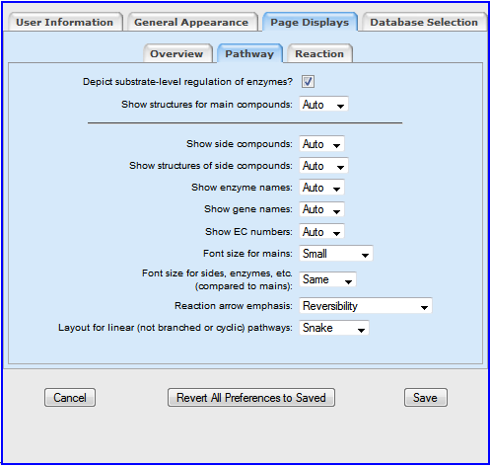
The Web Account System
Creating a web account enables you to:
Save SmartTables
Run metabolic models
Save organism groups for comparative analysis
Define a favorite database

Slide 42
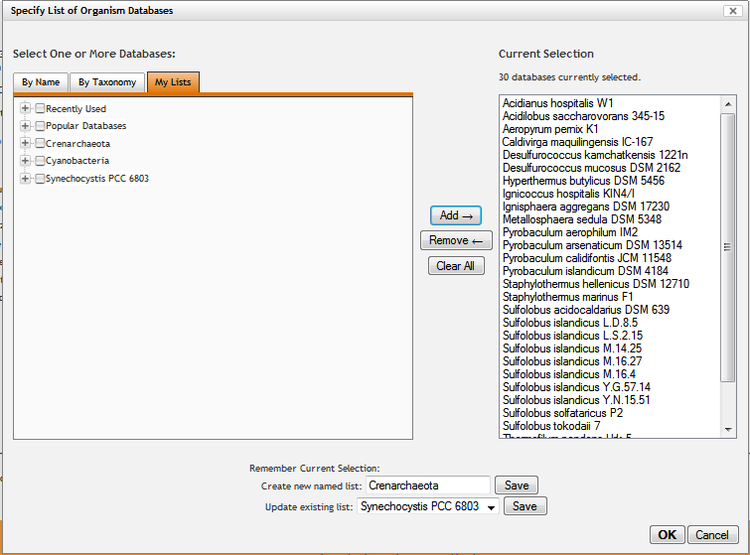
Save Organism Groups with Web Accounts
Note the My Lists tab on the multi-organism selector for comparative analyses.
When you perform comparative analyses, you can easily save groups of organisms for re-using at a later time.

Slide 43
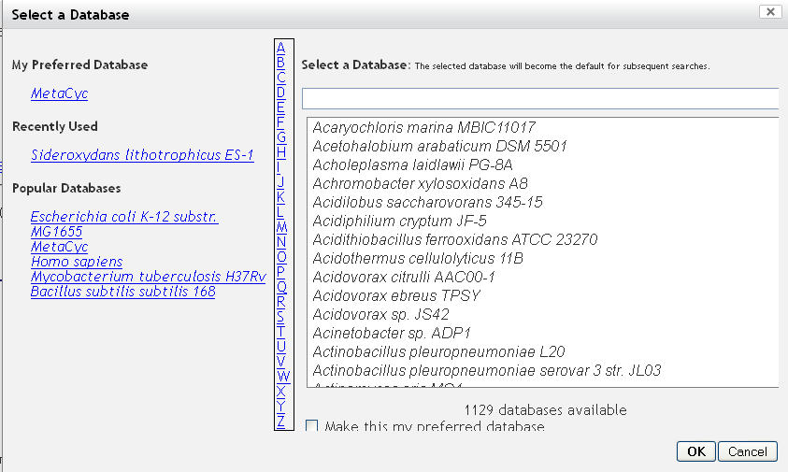
Define a Favorite Database with Web Accounts
If you create a web account, you can define a favorite database that will be opened by default when you login

Slide 44
Searching a Database

Slide 45
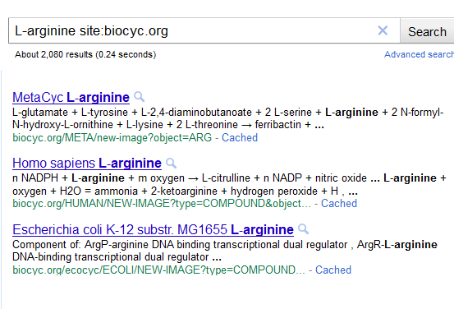
Why the Need for Dedicated Search Tools
Google search in BioCyc for “L-arginine”
2080 results
Need to have specific tools for finding exactly what we want

Slide 46
BioCyc Searches
Multiple searches available for finding information in different ways
The easiest searches to use are fairly coarse
Start by selecting database to search
Simplest search: Quick Search
At upper right of most pages

Slide 47
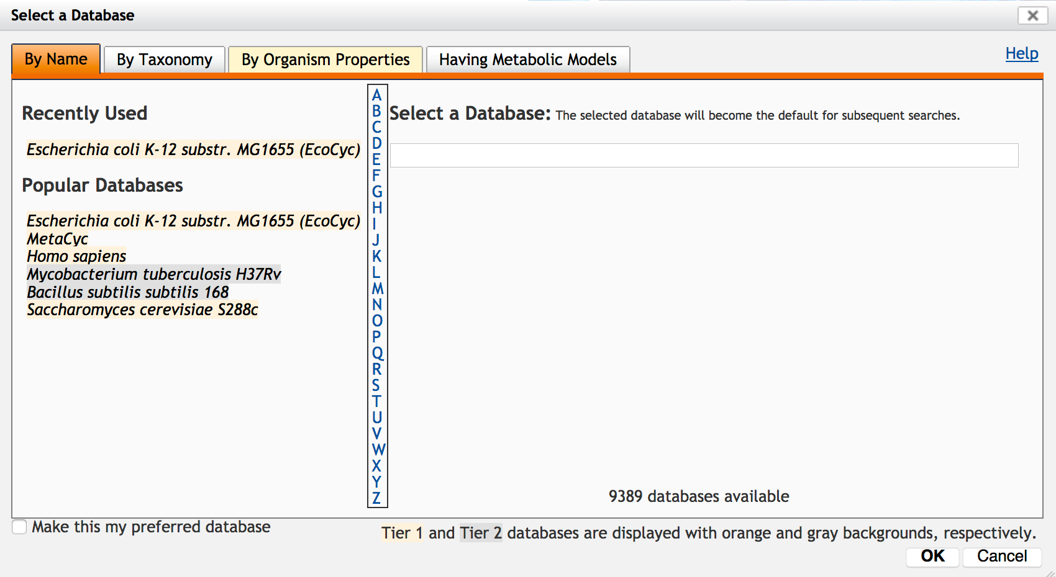
Selecting the Database
You can only search one database at a time*!
* With the exception of Google searches and Cross-Organism search
Click on word “change” under Search menu or under Quick Search button
In resulting selector, choose a PGDB
Start typing a word in organism name
Click on letter to navigate to organisms starting with that letter
Click a frequently used PGDB
Select by Taxonomy
All subsequent searches will apply to that database

Slide 48
Two organism/database selectors!
There are two different organism selectors in BioCyc
The first one is the selector found at the top of the page, which selects a single organism/database, which is then used for most searches.
The second one is a multi-organism selector, used for comparative analyses (See Tools → Comparative analysis → Choose organisms).

Slide 49
The Quick Search Box
What can you type here:
Gene name (dnaA )
Compound name (L-lysine)
Pathway name (peptidoglycan biosynthesis)
Reaction name (lysine decarboxylase)
Protein name (peptidase)
EC number (1.3.1.26)
Organism name (Escherichia coli)
Frame ID (CPLX-8024)
GO term (0006086)
Identifiers from other databases such as KEGG, PubChem, UniProt (O33998)
An exact term using the format (Peptidase D search:exact)
Limited term (hydrogen type:compound)
What doesn’t work:
Exact text using the Google format (“peptidase D”)

Slide 50
Demo script is in:
Talks/ecocyc/demo/demo-nav-intro.pptx

Slide 51
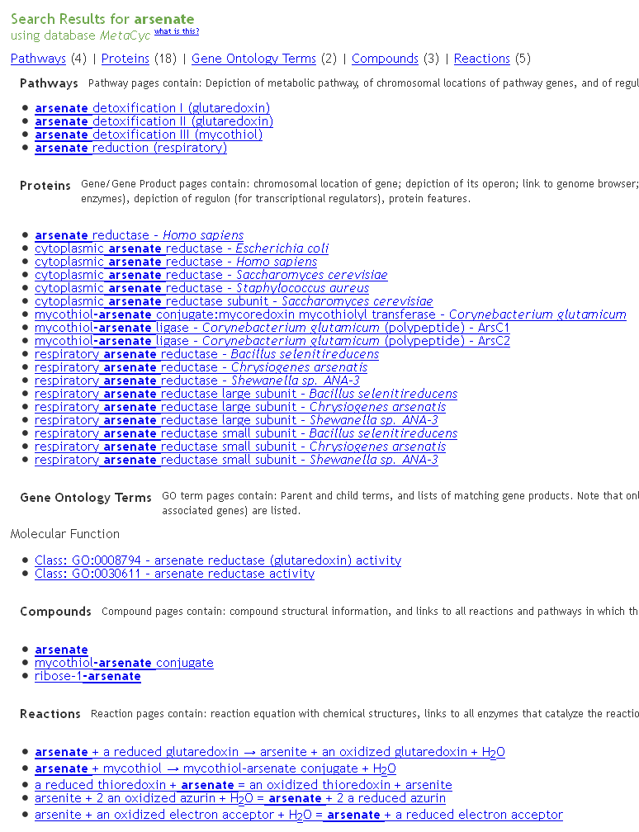
Quick Search Results
Results are divided into multiple categories

Slide 52
Examples of searches performed by users of the BioCyc website:
Successful Unsuccessful
Ascorbate pheV
EC 3.4.17.5 Transmembrane helix 6
Sigma factor 3.4.24.B11
Polysulfide reductase ABC cobalt transporter
Entner-Doudoroff pathway affinity of DnaA
Cyanobacteria
DnaA
A simple auto-correction mechanism tries to correct typos. For example, searching for “sacrosine” will find “sarcosine”.

Slide 53
Quick Gene Search
Useful when only interested in genes.
For example, compare the results when searching for “dnaA” by using the Quick Search and Gene Search buttons.

Slide 54
Exercises: Find these entities in E. coli O157:H7 str. G5101
Gene
Metabolite (Compound)
Reaction
Pathway
deoD
adenine
adenine phosphoribosyltransferase
queuosine biosynthesis

Slide 55
Information Present in Curated DBs
Gene
Summaries, protein features, GO terms, kinetic data, protein complexes, regulation
Metabolite (Compound)
Summaries
Reaction
Pathway
Summaries, regulation
Transcription Unit
Promoters, TF binding sites, terminators, regulatory interactions

Slide 56
Additional Page Types
Organism Summary Page
Organism phenotype data
Listed on organism summary page
Web: Change Org Database then Select by Org Properties
Curator page, Organization page
Desktop: Tools->Search->Curators / Organizations
Metabolic models
Web: Metabolism->Run Metabolic Model

Slide 57
Additional Page Types
“All Growth Media” page, pages for individual growth media
Desktop: Tools->Search->Growth Media
Note “Show All Growth Media” button
Web: Search->Search Growth Media
Note “All Growth Media for this Organism” button
Link from Organism Summary page
Links from metabolite pages
Link from list of gene essentiality datasets
Phenotype microarray data
Link from Organism Summary page
Listed on “All Growth Media” page
Gene essentiality data
Links from organism summary page

Slide 58
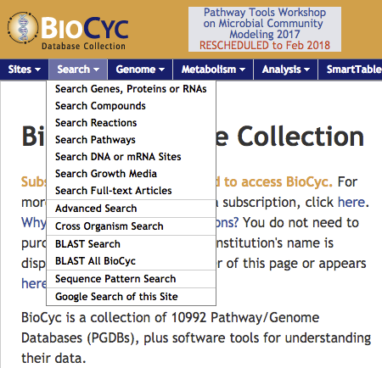
BioCyc Search Menu

Slide 59
Google This Site
The BioCyc site is indexed by Google
You can launch a Google text search from:
1. Search → Google This Site
2. The alternative searches box that appears on Quick Search results pages

Slide 60
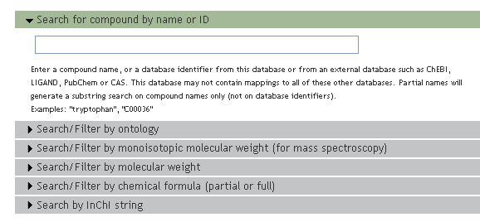
Object-Specific Searches
The first six items in the search menu provide a medium-level search interface against single types of objects
Use of filtering
Click on triangles at the left to expand or hide filters
Note that if a filter is hidden it will not be used in a search

Slide 61
Compound Search
List All buttons – quick way to get complete lists
Examples for compound searching:
Notes:
Select an organism specific PGDB, go to Search Pathways, and click on the list All button to generate a list of the pathways. Point out the different List All buttons available.
Compound searches:
Example 1: select MetaCyc. Search Compound, expand the chemical formula filter, and type Cl2F. Could take a while though.

Slide 62
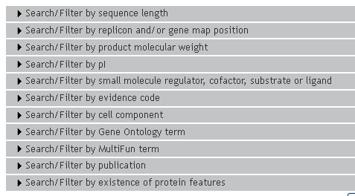
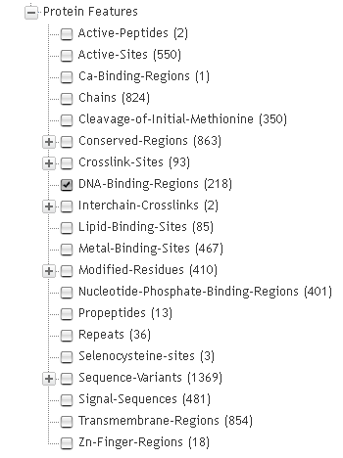
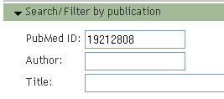
Search Genes/Proteins/RNAs
List All buttons – quick way to get complete lists
Extensive filtering options
Notes:
For a quick and simple live example, you can:
Select EcoCyc
Search for proteins with pI between 5 and 6 (211 results).

Slide 63
Exercises
Find all E. coli K-12 proteins less than 100 residues in length with a pI > 8

Slide 64
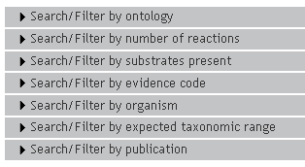
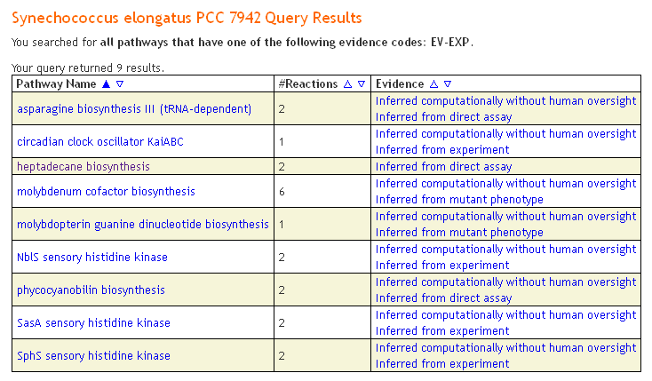
Search Pathways

Slide 65
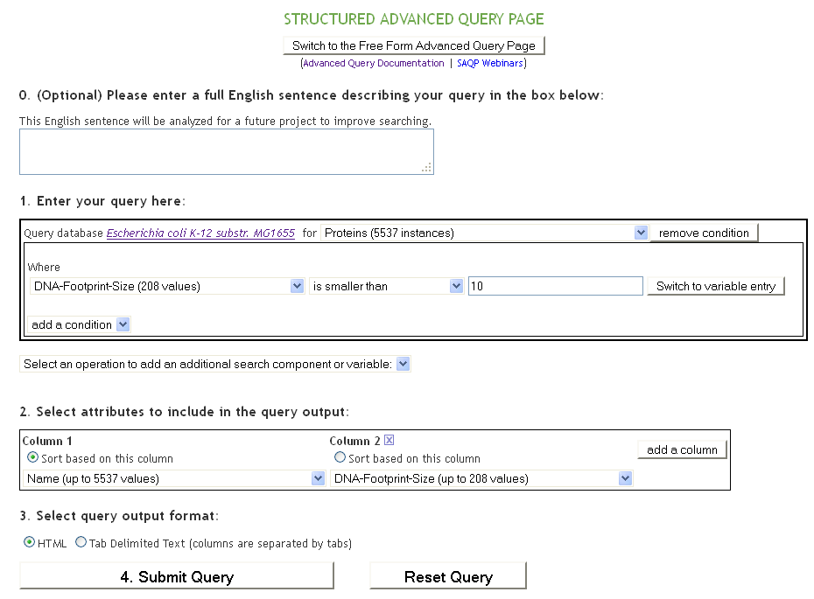
Advanced Search
The BioVelo query language
SAQP: Structured Advanced Query Page
Permits the definition of complex searches without mastering BioVelo.
To learn more about the advanced query interface, see online documentation.

Slide 66
Sequence Search by BLAST
Enables BLASTing sequences against individual BioCyc PGDBs
The results are linked to the PGDB gene/protein pages
Special cases:
BLAST against MetaCyc
BLAST against all of BioCyc

Slide 67
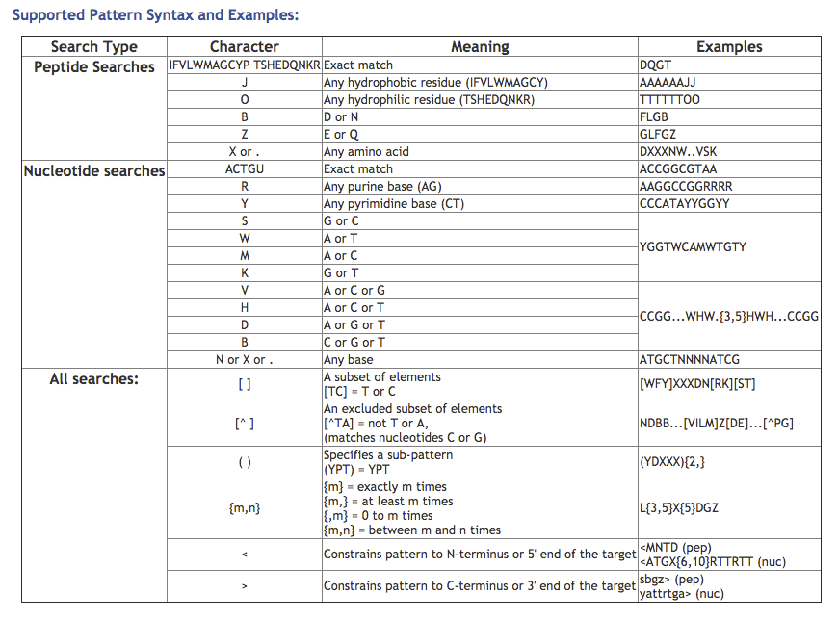
Sequence Pattern Search
Search for short nucleotide or protein sequence patterns (< 20)

Slide 68
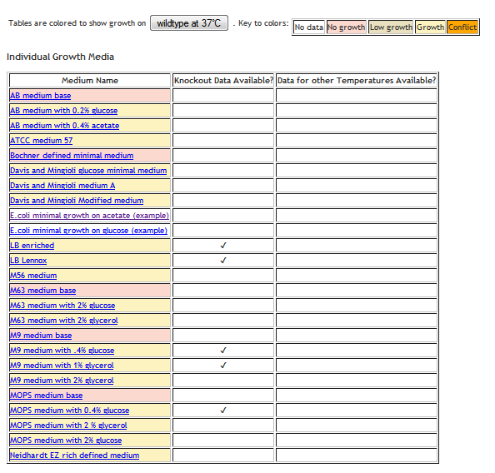
Growth Media and Phenotype
The desktop version of Pathway Tools allows definition of growth media, gene knockout growth information, and growth data for phenotype microarray plates.

Slide 69
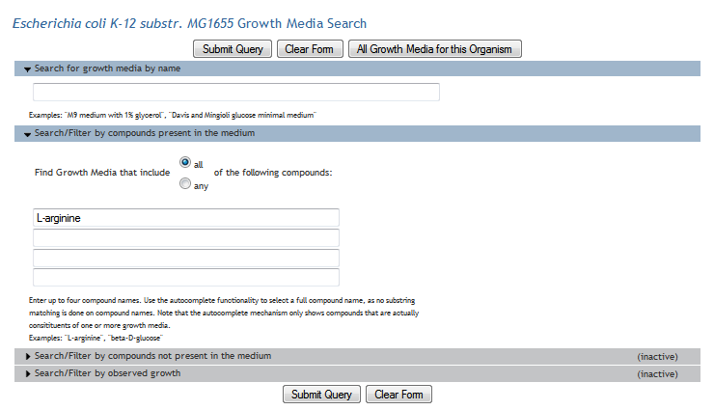
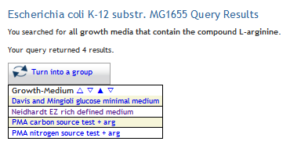
EcoCyc-Specific Searches: Growth Media
Search for growth media based on:
name
compounds present
compounds not present
observed growth

Slide 70
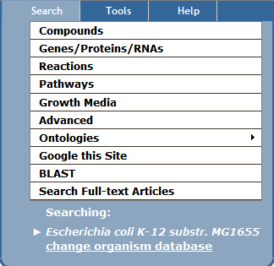
EcoCyc-Specific Searches: Textpresso
Mining E. coli literature poses special challenges – because almost every molecular biology paper references E. coli
The solution – EcoCyc Textpresso! An E. coli only collection of literature
30,000 full-text articles and 6,500 abstracts.
Full text literature searches
Results presented at bottom of page
Notes:
Search examples:
Fields:
Yanofsky, leave fields as the default
Yanofsky, change fields to author only.
Combination of words: (change fields back to abstract/body/title)
tryptophan yanofsky -- keyword: 467 matches in 264 documents
tryptophan,yanofsky -- keyword: 30166 matches in 6396 documents
Omitting words:
attenuation: 4173 matches in 1376 documents
Attenuation –tryptophan: 3929 matches in 1337 documents
Phrases
"attenuation control" : 455 matches in 171 documents

Slide 71
Web Version Lab Exercises

Slide 72
Web Lab Exercises
In EcoCyc:
Retrieve gene aroA
Retrieve all kinases
Retrieve all membrane proteins that cite an article by Gross
Retrieve all genes whose product interacts with ppGpp as a regulator or cofactor

Slide 73
Web Lab Exercises
In EcoCyc:
Retrieve gene aroA
Enter aroA in quicksearch
Retrieve all kinases
Enter “kinase” in quick search
Retrieve all membrane proteins that cite an article by Gross
Search -> Search Genes, Proteins, or RNAs
Open Search/Filter by Publication, enter author “Gross”
Retrieve all genes whose product interacts with ppGpp as a regulator or cofactor
Search -> Search Genes, Proteins, or RNAs
Open Search/Filter by small molecule regulator, cofactor, … or ligand
Click all boxes except for “Enzyme or Transporter Substrate” and enter ppGpp as the small molecule

Slide 74
Web Lab Exercises
In MetaCyc:
Retrieve reaction with EC# 5.3.1.9
Retrieve all reactions involving glutamate as a substrate
Find genes involved in fatty acid degradation
Find all pathways involved in degradation of arginine

Slide 75
Web Lab Exercises
In MetaCyc:
Retrieve reaction with EC# 5.3.1.9
Enter 5.3.1.9 in quicksearch, or
Search -> Reactions, enter 5.3.1.9 in first text box
Retrieve all reactions involving glutamate as a substrate
Search -> Reactions
Open Search/Filter by reactants or products
Enter glutamate
Find genes involved in fatty acid degradation
Search -> Pathways, open Search/Filter by Ontology
Click Degradation, Fatty Acid and Lipid Deg, click Fatty Acid Deg
Click on each of the two pathways, genes are shown
Find all pathways involved in degradation of arginine
Find arginine in quick search, click to arginine page, click Reactions tab

