Slide 1
The MultiOmics Explainer

Slide 2
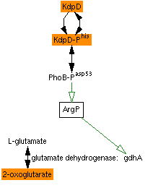
Motivation
Metabolomics experiment finds that knocking out gene kdpD affects level of 2-oxoglutarate in cell.
Can this be explained by existing knowledge? If so, how?

Slide 3
The MultiOmics Explainer
Goal: Use a PGDB’s metabolic and regulatory network to suggest explanations for the results of omics experiments.
Operates on transcriptomics, proteomics and metabolomics data, or any combination thereof.
Uses only metabolic and regulatory interactions defined in PGDB – does not attempt to infer new relationships.
Best for analyzing a small set of entities (< 25).
Best when regulatory network is as complete as possible, i.e. EcoCyc.

Slide 4
Directed Mode
User specifies one or more “condition” entities and one or more “effect” entities.
Tool attempts to find causal relationships that show how the conditions affect the effects.
Best when condition involves a specific entity of known function.
Example applications:
Experiment measuring changes in transcriptome in response to addition of some nutrient: the nutrient is the condition, the changed genes are the effects.
Experiment measuring metabolite and expression changes in response to a gene knockout: the knocked out gene is the condition, the changed metabolites and genes are the effects.

Slide 5
Undirected Mode
User specifies multiple effect entities
Tool attempts to find a small set of “influencers” that explain how effect entities are related.
Best when condition is either
Not a specific entity (e.g. a general environmental condition)
An entity that does not exist in the PGDB (e.g. an antibiotic)
An entity whose function is unknown, so not connected to other entities in PGDB.
Finding common influencers can suggest possible function or mode of action.
Examples:
Experiment measuring changes in response to knocking out a gene of unknown function.
Experiment measuring changes in response to exposure to some foreign compound.

Slide 6
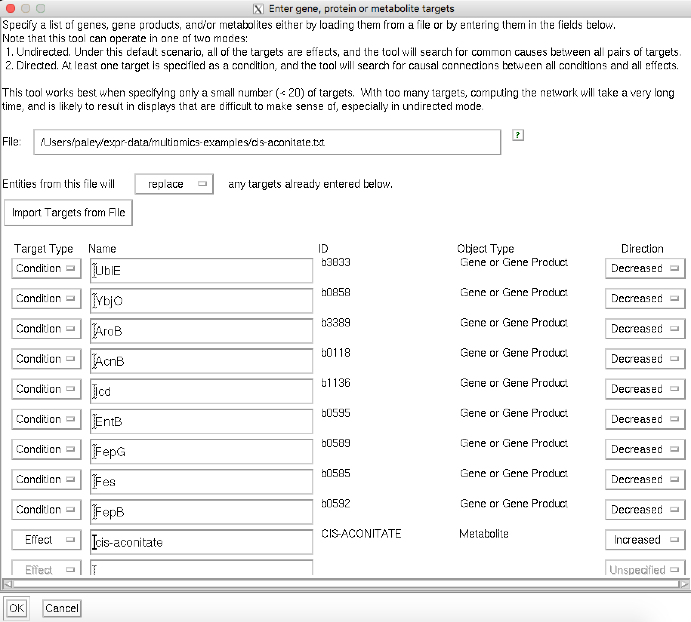
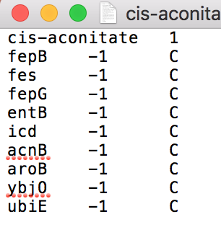
Using the MultiOmics Explainer
Tools -> MultiOmics Explainer
Targets -> Specify New Set of Targets
Optional input file is tab-delimited, with columns for entity, direction of change, condition/effect.

Slide 7
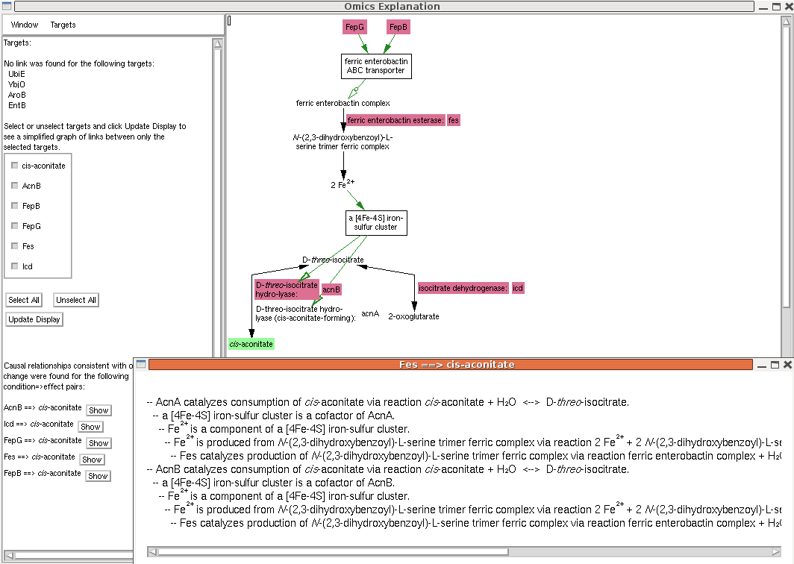

Slide 8
Types of influence on an entity X:
Substrates and enzymes of reactions that produce or consume X
Cofactors and substrate-level modulators of enzyme activity
Transporters of X
Transcriptional and translational regulators of X, including sigma factors
Ligands or other entities that bind to X to activate or inhibit it
If no path found, or if only paths identified seem implausible, then probably a gap in the metabolic or regulatory network. Either:
Path of influence is unknown: suggests avenue for future research
Data missing from PGDB

