Slide 1

Using Pathway-tools for phenotype-directed curation
Jeremy Zucker
Broad Institute of MIT and Harvard
Boston University
Notes:
1
Despite Neurospora’s rich history in the discovery of metabolism, so far no one has succeeded in integrating all of Neurospora’s biochemistry into a quantitative model that enables us to make new predictions based on that knowledge.
(why we developed a model. What we did to build the model. How we validated it. Where were are going with it in the Future.

Slide 2
Genome sequence to metabolic reconstruction

Slide 3


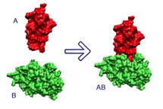

Genome sequence to metabolic model
Elements
Pathways
Literature
Metadata
Nutrient
media
(Vogels)
Reactions
Complexes
NeurosporaCyc
Biomass composition
Transporters

Slide 4



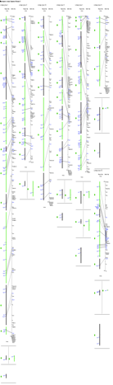

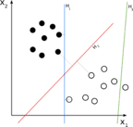
EFICAz2 predicts enzymes
Databases
1993 enzymes
1770 reactions
9934 protein
sequences
HMMs
FDR
Decision tree
…
SVM
BMC Bioinformatics 2009, 10:107

Slide 5

Protein Complex editor
56 complexes experimentally validated through literature search
182 reactions with isozymes or complexes
Identify multiple genes of reaction
Present all possible combinations of complexes
2-oxoisovalerate complex
2-oxoisovalerate alpha subunit
2-oxoisovalerate beta subunit
…
fatty acid synthase beta
subunit dehydratase
fatty acid synthase alpha
subunit reductase
Allow curator to validate potential complexes
…
Fatty acid synthase
complex

Slide 6
Transport inference parser (TIP)
Filter proteins for transporters
442 transport reactions
9934 free-text
Protein annotations
Infer multimeric complex
MFS glucose transporter
ATP synthase
…
sucrose transporter
Infer substrate
…
Infer energy-coupling mechanism
Bioinformatics (2008) 24 (13): i259-i267.

Slide 7
Pathologic predicts pathways
1770 enzyme-
catalyzed
reactions
893 reactions assigned to
265 Pathways
X = #rxns in metacyc pwy
Y = #rxns with enzyme evidence
…
…
Z = #unique rxns in pwy
P(X|Y|Z) = prob of pwy in Neurospora
Science 293:2040-4, 2001.

Slide 8
Literature curation validates pathways
523 citations associated with
265 pathways
56 complexes
524 genes
…
…

Slide 9
Phenotype-directed curation
Notes:
This next section describes some of the kinds of phenotypes we have used to validate the model, and how well we did at predicting it.

Slide 10
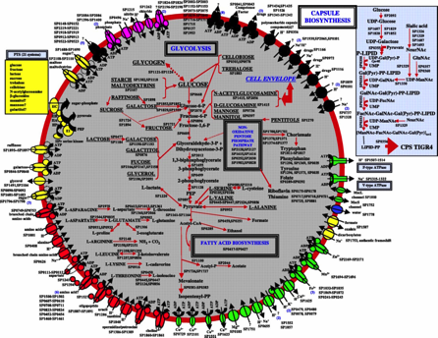
Knockout Phenotype Prediction
Nutrient Uptake
Metabolic Model
+
Steady State Assumption
=
Predict Rate of Biomass Production
Biomass Components
Notes:
One of the early success stories with genome-scale metabolic models is that they allow you to predict growth phenotypes. Given a nutrient media, if you can produce all of the essential compounds necessary for biomass, this is a prediction of growth.

Slide 11
Knockout Phenotype Prediction
Nutrient Uptake
Simulate KO by removing reaction
Are any biomass components blocked when applying FBA?
  No: non-essential gene
  Yes: essential gene
Biomass Components
Notes:
Furthermore, when you knock out a gene in vivo, you can model this by removing the reaction from the model that the enzyme catalyzes. If the model is still able to produce all of the essential biomass components, then the gene is predicted to be non-essential. On the other hand, if you can no longer produce a biomass component, then this is a prediction of an essential gene.

Slide 12
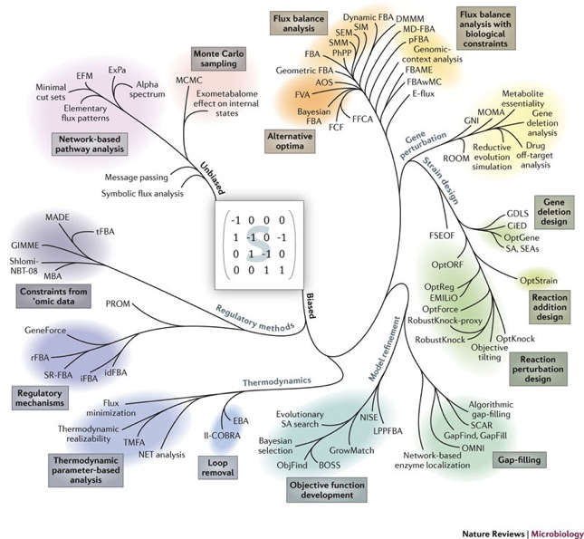
Why is it useful?
Notes:
All models are wrong, but some are useful. In the last few years, there has been an explosion in the diversity of methods that have been applied to genome-scale metabolic models. In particular, methods that predict the effect of gene perturbation, methods that enable one to design novel strains with desired behaviors, methods that take into account omics data to predict the effect of regulation on metabolism, and methods that enable you to refine the model based on phenotype data.
DON’T FORGET TO REFERENCE THE FIGURE!!!

Slide 13
Notes:
At this point, model doesn't grow on minimal medium, but we want it to grow/not-grow in a variety of conditions in sync with experimental observation
Model needs changes, but there are a combinatorial explosion of what rxns can be added/removeed
So, we needed optimization-based procedure to make suggestions
Point: need changes, so need opt

Slide 14
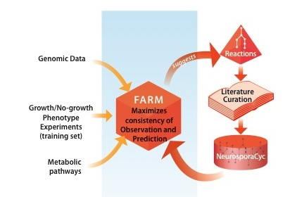
Phenotype-directed curation
Notes:
Our algorithm is called fast automated reconstruction of metabolism (FARM)
* accounts for more information, as I spoke about earlier
* has other improvements over previous algorithms for increased efficiency & accuracy
Suggestions by FARM are curated through the literature, and if we're confident in them, they are used to modify the model.
This process continues until all the phenotypes are fit as accurately as possible
Point: benefits of farm, then process

Slide 15
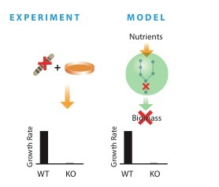
461 curated minimal media viable and essential genes
Notes:
from phenotypes u saw & from lit, we found growth/no-growth of 461 knockouts
our comparison is between model & experiment
train: as you can see we where highly accurate in our training set.
these numbers are exemplary for such gene essentiality tests on metabolic models

Slide 16
Minimal media gene essentiality training set
 |  | Predicted
 |  | Growth | No-growth
Observed | Growth | 103 (TP) | 0 (FN)
 | No-growth | 2 (FP) | 46 (TN)
 | Sensitivity | TP/(TP+FN) | 100%
 | Specificity | TN/(TN+FP) | 95.8%
Notes:
This was the data used to improve our model

Slide 17
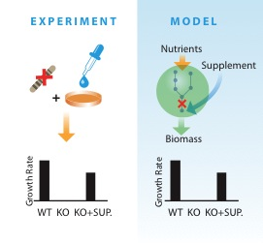
105 auxotroph supplemental rescue phenotypes
Notes:
another kind of test was on supp auxotrophs
these were strains that couldn’t grow after knockout, but could be rescued by adding a supplement

Slide 18
Supplemental rescue training set
 |  | Predicted
 |  | Growth | No-growth
Observed | Growth | 74 (TP) | 3 (FN)
 | Sensitivity | TP/(TP+FN) | 96.1%
Notes:
as u can see, we also did very well on these, showing that when we were correct about predicting no-growth, we were predicting it for the right reasons

Slide 19
Final metabolic reconstruction
Elements
224 Pathways
523 Citations
Metadata
Nutrient
media
(Vogels)
1650 Reactions
56 Complexes
NeurosporaCyc
Biomass composition
442 Transporters
Notes:
these are the statistics of the final model after training, with 4 compartments. it’s quite extensive in terms of data and metadata

Slide 20
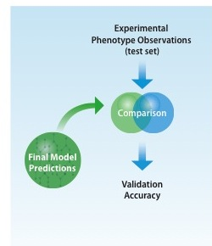
Independent test set validation
Notes:
so we seem to have a good model, but does it accurately predict new data??
to find this out, we tested our model on experimental observations that the model had not seen, i.e. on data the model had been blind to

Slide 21
Minimal media gene essentiality test set
 |  | Predicted
 |  | Growth | No-growth
Observed | Growth | 274 (TP) | 20 (FN)
 | No-growth | 1 (FP) | 15 (TN)
Viable predicted/observed (sensitivity): 93.2%
Essential predicted/observed (specificity): 93.8%
Notes:
From 310 conditions, this shows the high accuracy of our model
Unfortunately, it was difficult to extract essential genes, since these were grouped w/ slow growers in the knockout experiments and in the literature
So we had to manually curate these in the literature & were therefore unable to obtain a large observed no-growth test set

Slide 22
Comparison of model organisms under minimal media
 | Yeast 4.0¹ | E.coli iJO1366² | Neurospora
Viable Predicted/ Observed | 691/772=89.5% | 1079/1159=91.2% | 274/294=93.2%
Essential Predicted/Observed | 49/152=32.3% | 168/207=81.2% | 15/16=93.8%
[1] Dobson et al. BMC Systems Biology 2010, 4:145
[2] Molecular Systems Biology 7 Article number: 535
Notes:
When viewed against recent the validated phenotype predictions in other well-studied organisms such as Yeast and E. coli, we see that our predictions compared quite favorably.

Slide 23
Supplemental rescue test set
 |  | Predicted
 |  | Growth | No-growth
Observed | Growth | 23 (TP) | 5 (FN)
Rescues predicted/observed (sensitivity): 82.1%
trp-1,3 rescued by tryptophan
nic-3 rescued by nicotinamide
cys-11 rescued by sulfate, thiosulfite, methionine, cysteine
Notes:
shows that the no-growth calls in our gene essentiality test were for the right reasons, since our model was relatively accurate in rescuing them

Slide 24
Multiple knockouts
Notes:
This next section describes some of the kinds of phenotypes we have used to validate the model, and how well we did at predicting it.

Slide 25
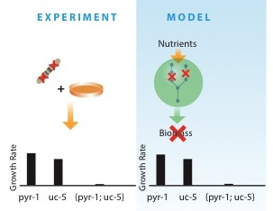
Synthetic Lethality
Notes:
An additional use of our model is to test synthetic lethality
This is hard to identify experimentally, but easy to find computationally
Left shows the experiment, right shows computational procedure for the double-KO {pyr-1;uc-5

Slide 26
Pathway interpretation
Notes:
w/ only one, can make uridine-5-phosphate, but can’t w/ neither, & uridine-5-phosphate is an essential element to make biomass

Slide 27
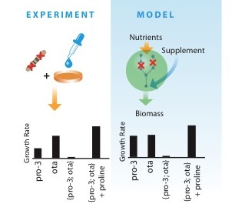
Synthetic lethal rescues computationally predicted
Notes:
Furthermore, we can rescue these double-Kos which can’t grow
Eg {pro-3;ota}

Slide 28
Pathway interpretation
Notes:
Need glutamate gamma-semialdehyde

Slide 29
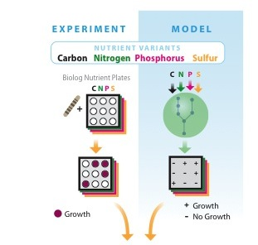
Phenotype arrays
Notes:
Biolog 96 well plates w/ diff nutrients in each well
We’re doing 4 plates, so nearly 400 nutrient conditions. Sulfur, Phosphorous, Nitrogen, Carbon.
We have performed the experiments and have preliminary data.

Slide 30
Acknowledgements
Boston University
James Galagan
Jonathan Dreyfuss
Andrew Krueger
OHSU
Heather Hood
Texas A&M
Joe Sturino
Matt Sachs
UC Riverside
Kathy Borkovich
Jacqueline Servin
University of Leeds
Alan Radford
SRI
Peter Karp
Mario Latendresse
Broad Institute
Christian Stolte
Citizen Scientist
Linda Ocasio

